Slide 1

OFF-LINE TEXT
DEPENDENT
WRITER RECOGNIZATION

Slide 2

PRESENTED BY:
SWAGARIKA JAHARLAL GIRI
SHREYA DAS
MOUSUMI NANDI

Slide 3

What is Writer recognition?
Writer recognition is to determine the writer of a text among a number of known writers using their handwriting images.

Slide 4
Classification
TEXT INDEPENDENT
TEXT DEPENDENT
Text dependent approach identification of writers is based on specific targeted handwritten text where all the writers write the same text
Text independent approach identification of document’s writer is based on any written text

Slide 5
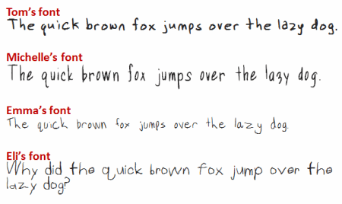
CHALLENGE
Writer Recognition is challenging as there is not only Between- Writer variation but also with-in writer variation.

Slide 6
CONTENT
Problem description
Database used
Classifier used
Feature extraction
Classification and Recognition
Experimental Result

Slide 7





PROBLEM DESCRIPTION
As each writer, handwriting visually differs from one another, each writer’s handwriting may be regarded as a different texture. These textures are taken as a unique characteristic to identify the writers. Identifying the unique feature is the challenge.

Slide 8
ISIHWD Database :
One Two Three Four Five Six Seven Eight Nine Ten Eleven Twelve Thirteen Fourteen Fifteen Sixteen Seventeen Eighteen Nineteen Twenty Thirty Forty Fifty Sixty Seventy Eighty Ninety Rupees Only hundred thousand lakh crore one two three four five six seven eight nine ten eleven twelve thirteen fourteen fifteen sixteen seventeen eighteen nineteen twenty thirty forty fifty sixty seventy eighty ninety rupees and only
Size: (90x5x62)+(7x4x62)+(8x3x62)=31124

Slide 9
Feature extraction
Feature extraction is the measured data and builds derived values (features) intended to be informative and non-redundant, facilitating the subsequent learning and generalization steps, and in some cases leading to better human interpretation
PRE- PROCESSING STEPS
SCANNED INPUT IMAGE
PROCESSED IMAGE FOR FEATURE EXTRACTION
BINARIZATION
RESIZE
Resized to 70x70 and 68x144 and compared the result of both.
Binarization the given gray image for efficient extraction of feature.

Slide 10
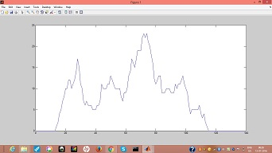
Diagonal projection +45 degree
Diagonal Feature
Feature vector for diagonal projection

Slide 11
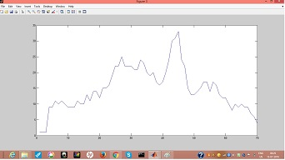
Diagonal feature
-45 degree
Feature vector for diagonal projection

Slide 12
Horizontal Projection
Feature Vector of Horizontal Projection
Horizontal Projection

Slide 13
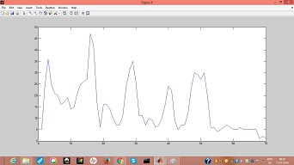
VERTICAL PROJECTION
Vertical Projection
Feature Vector of Vertical Projection

Slide 14
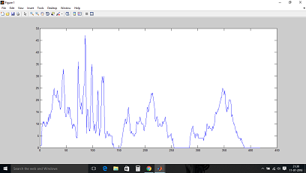
CLASSIFICATION AND RECOGNIZATION
This is the concatenated feature vector of Horizontal, Vertical, +45 degree and -45 degree projection.
Example of plotted Feature Vector.

Slide 15

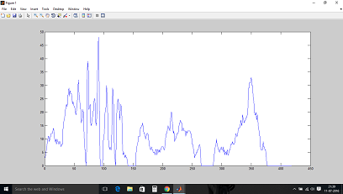
Plotted Feature Vector for Same Writer
The plotted feature vector clearly explains that there is great similarity
between the feature vector of the text depended writing of same writer.
This similarity between the feature vector of text of same writer
lead to proper classification

Slide 16

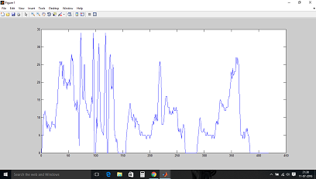
Plotted Feature Vector for different Writer
Plotted feature vector of 2 different writer and there is great difference in the plotted feature vector. The difference can easily be identified. This difference in the feature vector is used to identify the difference between the 2 different writer

Slide 17
EXPERIMENTAL RESULT
1 TRAIN AND 4 TEST
2 TRAIN AND 3 TEST

Slide 18
3 TRAIN AND 1 TEST
4 TRAIN AND 1 TEST

Slide 19
Final Experimental Result .

Slide 20

THANK YOU

